Slide 1
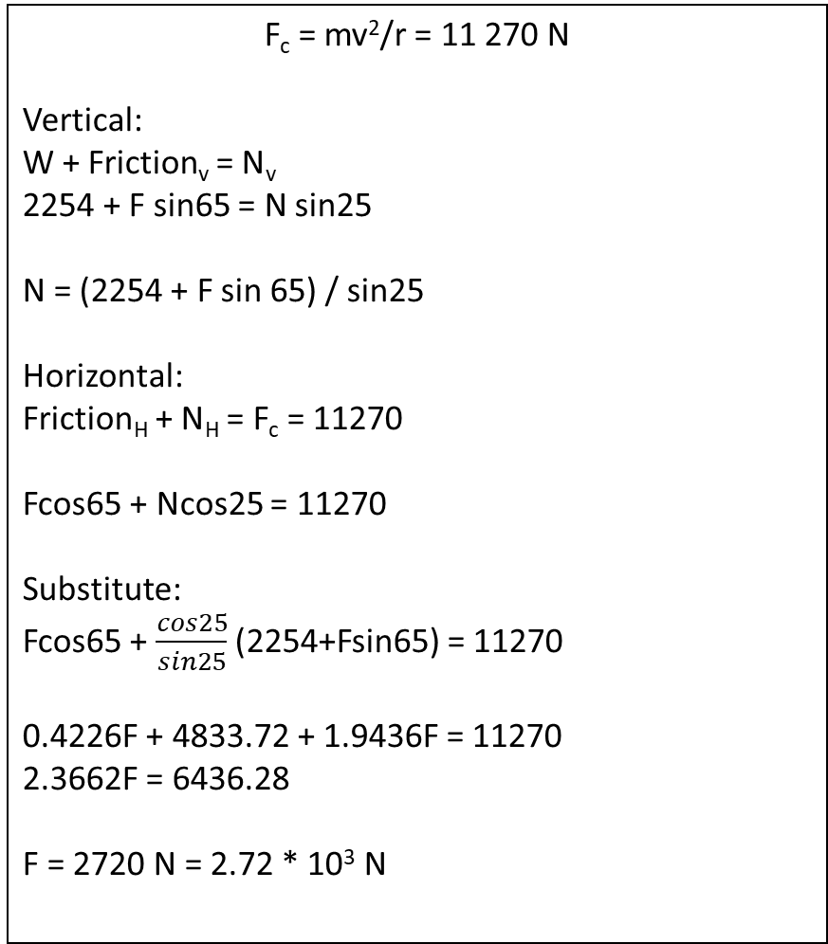
17a) Vector diagram
17b) calculations
F_{c}
F_{c} = mv²/r = 11 270 N
Vertical:
W + Friction_{v} = N_{v}
2254 + F sin65 = N sin25
N = (2254 + F sin 65) / sin25
Horizontal:
Friction_{H} + N_{H} = F_{c} = 11270
Fcos65 + Ncos25 = 11270
Substitute:
Fcos65 + $\frac{cos25}{sin25}$ (2254+Fsin65) = 11270
0.4226F + 4833.72 + 1.9436F = 11270
2.3662F = 6436.28
F = 2720 N = 2.72 * 10³ N
W
Normal
Friction
17b) support diagrams
Friction
Normal
Friction_{V}
65º
N_{V}
Friction_{H}
25º
N_{H}

